Slide 1
Extending linear models by transformation
(section 3.4 in text)
(lectures 3&4 on amlbook.com)

Slide 2
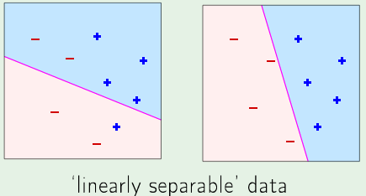
Usually only way to determine if data is linearly separable
is to try a linear model.
When number of attributes exceeds 2, viewing training
data as a scatter plot is not practical

Slide 3
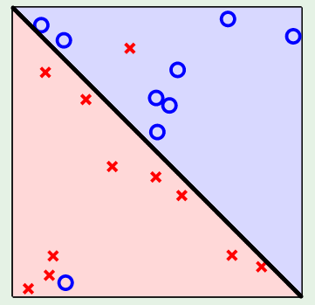
A linear model that has a small E_{in}(g) means the bulk
of training data is linearly separable.
Since linear models usually generalize well, a linear
model with small E_{in}(g) is probably the best choice

Slide 4
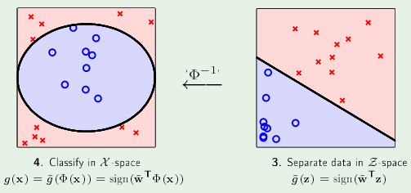
When members of a class tend to cluster, an elliptical
transformation, z = Φ(x) = (1, x₁² , x₂² ), might lead to
linearly separable features.
attribute space
feature space

Slide 5
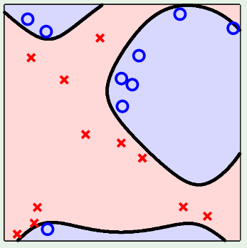
When a linear model in attribute space separates most
of the data, the transform to a space where E_{in}(g) = 0
(linearly separable) is likely to be complex.
attribute space
Complex boundaries
back-transformed
from feature space
Linear boundary

Slide 6
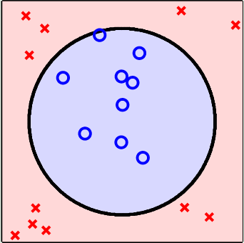

Data snooping
Choosing a transform by looking at a scatter plot
can be dangerous. Characteristics may only apply
to this dataset

Slide 7
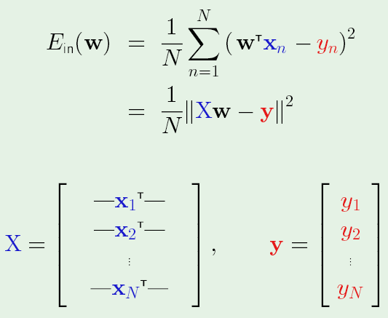
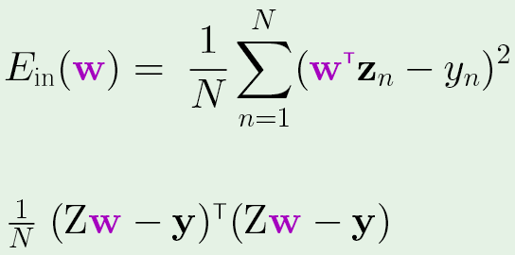
Non-linear transform usually discovered as improvement
on a linear model. To find the optimum weight vector, w,
replace attribute vectors x_{n} in the X matrix by corresponding
features, z_{n} = Φ(x_{n})
min E_{in} -> X^{T}Xw_{lin} = X^{T}y
min E_{in} -> Z^{T}Zw_{lin}= Z^{T}y

Slide 8
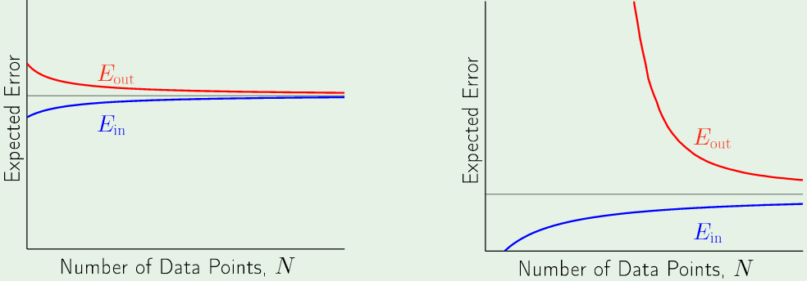
Learning curves: simple vs complex models
Still larger than bound set by noise
Complex models require more data points for good
performance. For N smaller than dotted line, simple
model is better.

Slide 9
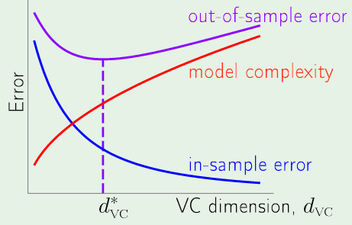
Extending linear models by transforms can lead to
“over-fitting” (smaller E_{in} but larger E_{out})
VC dimension is a measure of complexity
Model with d*_{VC} has min E_{out} not smallest E_{in}

Slide 10
d_{vc} as measure of complexity is usually not know
How do we estimate a good level of complexity?

Slide 11
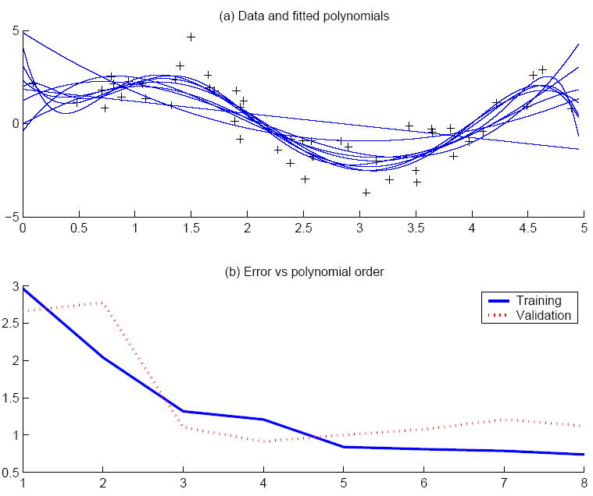
Approach used for 1D polynomial fitting applies to any measure of complexity
Use validation set to estimate E_{out}
“elbow” in estimate of E_{out} indicates best complexity
Lecture Notes for E Alpaydın 2010 Introduction to Machine Learning 2e © The MIT Press (V1.0)
11

Slide 12
Number features expands rapidly in multivariate polynomial
models. z_{2D quad} = Φ(x) = (1, x₁, x₂, x₁², x₂², x₁x₂)
Add terms sequentially and see how E_{val} changes

Slide 13
Curse of dimensionality: glass data
1 | 1.521 | 13.64 | 4.49 | 1.1 | 71.78 | 0.06 | 8.75 | 0 | 0 | 1
2 | 1.517 | 13.89 | 3.6 | 1.36 | 72.73 | 0.48 | 7.83 | 0 | 0 | 1
3 | 1.516 | 13.53 | 3.55 | 1.54 | 72.99 | 0.39 | 7.78 | 0 | 0 | 1
Extending the linear beer-bottle classifier to full quadratic changes
the size of the Z matrix from 9 to 81.
Some quadratic terms more important than others. Ignore terms
that do not decrease E_{val} significantly.
Large validation set makes this technique more affective

Slide 14
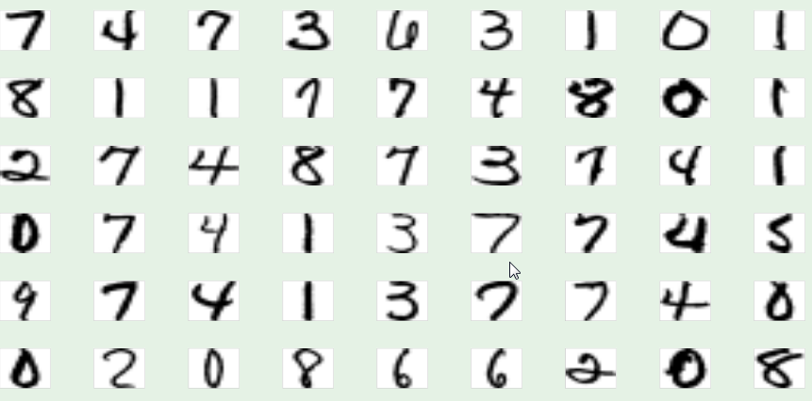
Classification for digit recognition
Examples of hand-written digits from zip codes

Slide 15
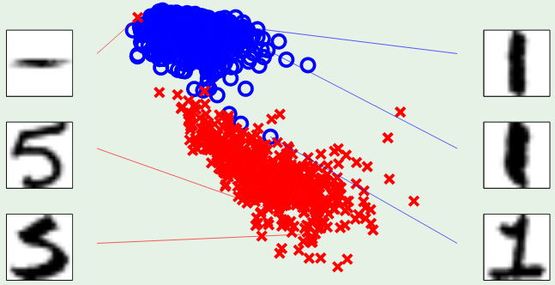
2-attribute digit model: intensity and symmetry
symmetry
intensity
Intensity: how much black is in the image
Symmetry: how similar are mirror images

Slide 16
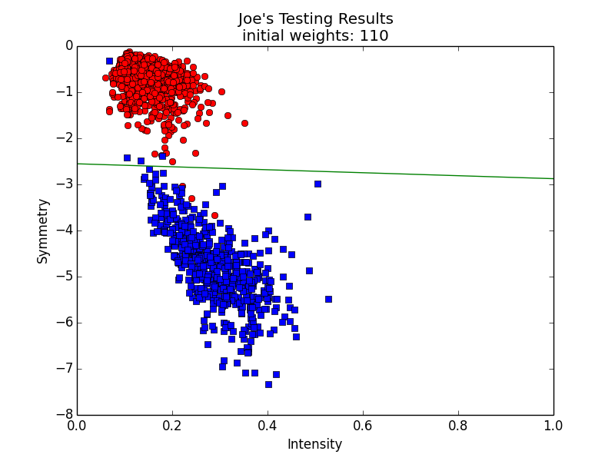
Linear classifier has accuracy ~ 0.99
ones
fives

Slide 17
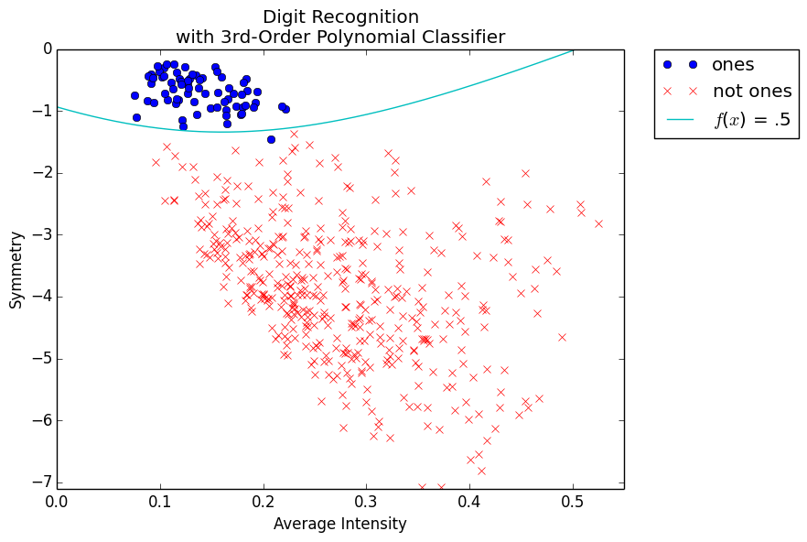
One vs Not One: Linear is good; cubic slightly better

Slide 18
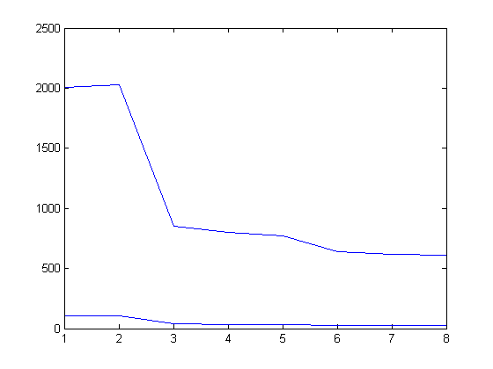
One vs Not One: finding the best complexity
E_{val} 8798 samples
Error
E_{in} 500 samples
L +x₁² +x₂² +x₁x₂ +x₁³ +x₂³ +x₁x₂² +x₁²x₂
Additional terms beyond linear

Slide 19
Discriminants in 2D binary classification
ones
fives

Slide 20
Discriminants: linear 2D binary classifier
y_{fit} (x) = w₀ + w₁ x₁ + w₂ x₂
r₁ and r₂ are numerical class labels
y_{fit} (x) = (r₁ + r₂)/2 defines the a function of x₁ and x₂
that is the discriminant
Solve this function for x₂ as a function of x₁

Slide 21
Discriminants: non-linear binary classifiers

Slide 22
By analogy with the linear 2D case
y_{fit} = w^{T}Φ(x) r_{b} = (r₁+r₂)/2
y_{fit} = r_{b} defines the discriminant
For a given x₁ define f(x₂) = w^{T}Φ(x) – r_{b}
Find the zeros of f(x₂)
(x₁, x₂) are points on the discriminant

